Slide 1
First Order Logic (Predicate Calculus)

Slide 2
This Lecture
Last time we talked about propositional logic, a logic on simple statements.
This time we will talk about first order logic, a logic on quantified statements.
First order logic is much more expressive than propositional logic.
The topics on first order logic are:
Quantifiers
Negation
Multiple quantifiers
Arguments of quantified statements

Slide 3
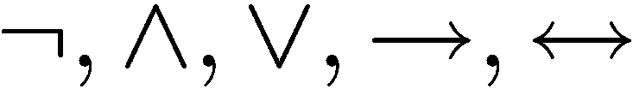
Limitation of Propositional Logic
Propositional logic – logic of simple statements
How to formulate Pythagoreans’ theorem using propositional logic?
b
c
a
How to formulate the statement that there are infinitely many primes?

Slide 4
Predicates
Predicates are propositions (i.e. sentences) with variables
And becomes a statement when specific values are substituted for the variables
Example:
P (x,y) ::=
x + 2 = y
x = 1 and y = 3: P(1,3) is true
x = 1 and y = 4: P(1,4) is false
¬P(1,4) is true
More Examples:
P(x) ::= x is a student at BUET
Q (x,y) ::= x is a student at y
When there is a variable, we need to specify what to put in the variables.
The domain of a variable is the set of all values
that may be substituted in place of the variable.

Slide 5


Set
To specify the domain, we often need the concept of a set.
Roughly speaking, a set is just a collection of objects.
R | Set of all real numbers
Z | Set of all integers
Q | Set of all rational numbers
Some examples
Given a set, the (only) important question is whether an element belongs to it.
means that x is an element of A (pronounce: x in A)
means that x is not an element of A (pronounce: x not in A)
Sets can be defined explicitly:
e.g. {1,2,4,8,16,32,…}, {CSE103,CSE105,…}

Slide 6

Truth Set
Sometimes it is inconvenient or impossible to define a set explicitly.
Sets can be defined by a predicate
Given a predicate P(x) and x has domain D, the truth set of
P(x) is the set of all elements of D that make P(x) true.
e.g.
Let P(x) be “x is the square of a number”,
and the domain D of x is the set of positive integers.
Then the truth set is the set of all positive integers which are the square of a number.
e.g.
Let P(x) be “x is a prime number”,
and the domain D of x is the set of positive integers.
Then the truth set is the set of all positive integers which are prime numbers.

Slide 7



The Universal Quantifier
The universal quantifier
∀x
for ALL x
Example:
∀ x Z ∀ y Z, x + y = y + x.
Pythagorean’s theorem
b
c
Suppose, a, b, c are the three sides of a triangle
If a, b, c are … then
a
Example:
This statement is true if the domain is Z (integers),
but not true if the domain is R (reals).
The truth of a predicate depends on the domain.

Slide 8
Truth and Falsity of Universal Statements
Let D = {1,2,3,4,5} and consider the statement: ∀x ∈ D, x² ≥ x. Show this is true.
∀x ∈ R, x² ≥ x. Show that this is false.
Take x = ½ . Clearly x ∈ R
(½)² = ¼ < ½
So, this is false
Method of Exhaustion
1² = 1 ≥ 1 | 2² = 4 ≥ 2 | 3² = 9 ≥ 3 | 4² =16≥ 4 | 5²=25≥ 5
TRUE | TRUE | TRUE | TRUE | TRUE
Counterexample

Slide 9
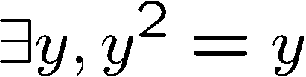
The Existential Quantifier
∃y
There EXISTS some y
e.g.
The truth of a predicate depends on the domain.
Domain
Truth value
integers 
T
positive integers ⁺
T
negative integers ⁻
F
Check -1.
negative reals ⁻
T

Slide 10
Truth and Falsity of Existential Statements
∃m ∈ Z, m² = m. Show that this is true.
Take m = 1 . Clearly m ∈ Z
(1)² = 1, So, this is true (at least for one element)
Let D = {5,6,7,8,9} and consider the statement: ∃m ∈ D, m² = m. Show this is false.
Method of Exhaustion
5²=25 ≠5 | 6²=36 ≠6 | 7²=49 ≠7 | 8²=64 ≠8 | 9²=81 ≠9
FALSE | FALSE | FALSE | FALSE | FALSE

Slide 11
Implicit Quantification
If a number is an integer, then it is a rational number
No quantification (for all/each/any)
But the presence of indefinite article ‘a’ before the number indicates universal quantification.
∀x, x∈Z → x∈Q
The number 24 can be written as a sum of two even integers
No quantification (there exists a/some)
∃ even integers m and n such that 24 = m+n

Slide 12
Translating Mathematical Theorem
Fermat (1637): If an integer n is greater than 2,
then the equation a^{n} + b^{n} = c^{n} has no solutions in non-zero integers a, b, and c.
∀n ∈ Z, n > 2
Notes:
https://en.wikipedia.org/wiki/Fermat%27s_Last_Theorem#:~:text=In%20number%20theory%2C%20Fermat's%20Last,of%20n%20greater%20than%202.

Slide 13


Translating Mathematical Theorem
Goldbach’s conjecture: Every even number is the sum of two prime numbers.
Suppose we have a predicate prime(x) to determine if x is a prime number.
How to write prime(p)?

Slide 14
Exercises
∀x ∈ R, x² ≥ 0
All real numbers have nonnegative squares.
Every real number has a nonnegative square.
Any real number has a nonnegative square.
x has a nonnegative square, for each real number x.
The square of any real number is nonnegative.
∀x ∈ R, x² ≠ -1
All real numbers have squares not equal to -1.
No real numbers have squares equal to -1.
∃m ∈ Z, m² = m
There is an integer whose square is equal to itself.
We can find at least one integer equal to its own square.
m² = m, for some integer m.
Some integer equals its own square.
Some integers equal their own squares.

Slide 15
Exercises
All triangles have three sides.
∀ triangles t, t has three sides
∀ t ∈ T, t has three sides (where T is the set of all triangles).
No dogs have wings.
∀ dogs d, d does not have wings
∀ d ∈ D, d does not have wings (where D is the set of all dogs)
Some programs are structured.
∃ a program p such that p is structured
∃ p ∈ P such that p is structured (where P is the set of all programs)

Slide 16
Equivalent Forms
All primes greater than 2 are odd
∀x( (Prime(x) ∧ x > 2) → Odd(x) )
∀x ∈ D Odd(x)
Here D consists of all values of the variable x such that x>2 and Prime(x) is true.
∀ x ∈ U, if P(x) then Q(x)
Equivalently we can say:
∀ x ∈ D, Q(x);
Here D consists of all values of the variable x that makes P(x) true.

Slide 17
Quantifiers
Negation
Multiple quantifiers
Arguments of quantified statements

Slide 18



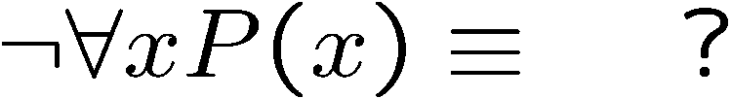
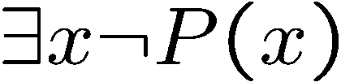


Negations of Quantified Statements
Everyone likes football.
What is the negation of this statement?
No one likes football.
Not (everyone likes football) = There exists someone who doesn’t like football.
(generalized) DeMorgan’s Law
Say the domain has only three values.
The same idea can be used to prove it for any number of variables, by mathematical induction.

Slide 19
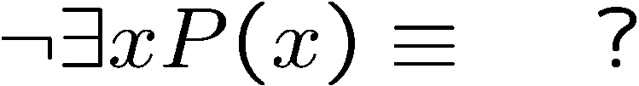
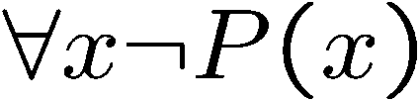

Negations of Quantified Statements
There is a plant that can fly.
There is a plant
that cannot fly.
What is the negation of this statement?
Not (exists a plant that can fly) = All plants/ Every plant cannot fly.
(generalized) DeMorgan’s Law
Say the domain has only three values.
The same idea can be used to prove it for any number of variables, by mathematical induction.

Slide 20
Negation Exercises
∀ primes p, p is odd.
∃ a prime p such that p is not odd.
∃ a triangle T such that the sum of the angles of T equals 200°
∀ triangles T, the sum of the angles of T does not equal 200°

Slide 21
Informal -> Formal -> Negate
No politicians are honest
Formal: ∀ politicians x, x is not honest.
Negation: ∃ a politician x such that x is honest.
Informal Negation: Some politicians are honest
All politicians are honest
Negate

Slide 22
Informal Negation: Ambiguity
All mathematicians wear glasses
Informally Negate:
All mathematicians do not wear glasses
Meaning 1: There are mathematicians who do not wear glasses.
Meaning 2: None of the mathematicians wears glasses.
Depends on the verbal stress

Slide 23
Negation of Universal Implications
¬ (∀x, P(x) → Q(x))
∃x such that ¬ (P(x) → Q(x))
∃x such that ¬ (¬ P(x) ∨ Q(x))
∃x such that (P(x) ∧ ¬ Q(x))
Example negation:
∀ people p, if p is blond then p has blue eyes
∃ a person p such that, p is blond and p does not have blue eyes

Slide 24
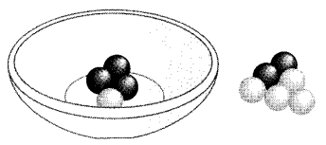



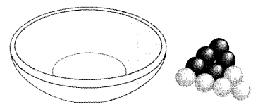


Vacuous Truth
We have 5 black and 5 white balls and a bowl
TRUE/FALSE?
All the balls in the bowl are black
P=
All the balls in the bowl are black.
Negation:
There exists a ball in the bowl that is not black.
¬ P=
Is there a ball in the bowl that is non-black, i.e., white?
P is FALSE if and only if ¬ P is TRUE

Slide 25
Vacuous Truth
∀x ∈ D, P(x) → Q(x) is vacuously true or true by default if and only if ∀x ∈ D, ¬P(x).

Slide 26
Contrapositive, Converse, Inverse
∀x ∈ D, P(x) → Q(x)
Contrapositive
∀x ∈ D, ¬ Q(x) → ¬ P(x)
Converse
∀x ∈ D, Q(x) → P(x)
Inverse
∀x ∈ D, ¬ P(x) → ¬ Q(x)

Slide 27
Contrapositive, Converse, Inverse
If a real number is greater than 2, then its square is greater than 4.
∀x ∈ R, x > 2 → x² > 4
Contrapositive
∀x ∈ R, x² ≯ 4 → x ≯ 2
Converse
∀x ∈ R, x² > 4 → x > 2
Inverse
∀x ∈ R, x ≯ 2 → x² ≯ 4

Slide 28






Necessity, Sufficiency, if, Only if
≡
≡
Contrapositive
≡
≡
Contrapositive
≡

Slide 29
Quantifiers
Negation
Multiple quantifiers
Arguments of quantified statements

Slide 30
Double Quantifiers
∀ x ∈ D, ∃ y ∈ E such that P(x, y)
How to establish the truth of the above?
For each element x in D
find an element y in E such that P(x, y)
∃ x ∈ D, such that ∀y ∈ E, P (x, y)
How to establish the truth of the above?
Find an element x in D for which each element y in E gives P(x, y)

Slide 31
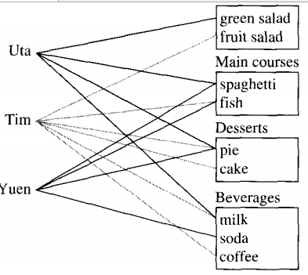
Exercises: Formal & truth value

Slide 32
Exercises: Formal & truth value
There is an item that was chosen by every student.
This is true; every student chose pie.
There is a student who chose every available item.
This is false; no student chose all nine items.
There is a student who chose at least one item from every station.
This is true; both Uta and Tim chose at least one item from every station.
Every student chose at least one item from every station.
This is false; Yuen did not choose a salad.
∃ an item I such that ∀ students S, S chose I.
∃ a student S such that ∀ items I, S chose I.
∃ a student S such that ∀ stations Z, ∃ an item I in Z such that S chose I.
∀ students S and ∀ stations Z, ∃ an item I in Z such that S chose I.

Slide 33
Order of Quantifiers
There is an anti-virus program killing every computer virus.
How to interpret this sentence?
For every computer virus, there is an anti-virus program that kills it.
There is one (single) anti-virus program that kills all computer viruses.

Slide 34
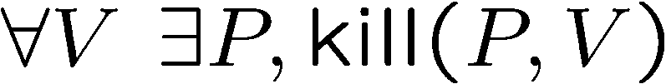
Order of Quantifiers
There is an anti-virus program killing every computer virus.
How to interpret this sentence?
For every computer virus, there is an anti-virus program that kills it.
For every attack, I have a defense:
against MYDOOM, use Defender
against ILOVEYOU, use Norton
against BABLAS, use Zonealarm …
 is expensive!

Slide 35
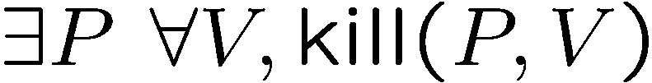
Order of Quantifiers
There is an anti-virus program killing every computer virus.
How to interpret this sentence?
There is one single anti-virus program that kills all computer viruses.
I have one defense good against every attack.
Example: P is CSE-antivirus,
protects against ALL viruses
That’s much better!
Order of quantifiers is very important!

Slide 36
Order of Quantifiers
There is a person supervising every detail of the production process.
How to interpret this sentence?
There is one single person who supervises all the details of the production process.
∃p such that ∀ pp supervise(p, pp)

Slide 37
Order of Quantifiers
There is a person supervising every detail of the production process.
How to interpret this sentence?
For any particular production detail, there is a person who supervises that detail
(but there might be different supervisors for different details.)
∀ pp, ∃p such that supervise(p, pp)

Slide 38
Order of Quantifiers
There is a person supervising every detail of the production process.
How to interpret this sentence?
∃p such that ∀ pp supervise(p, pp)
∀ pp, ∃p such that supervise(p, pp)
In real life we have this sort of ambiguous situation and depending on the context we realize which one is actually intended for.

Slide 39
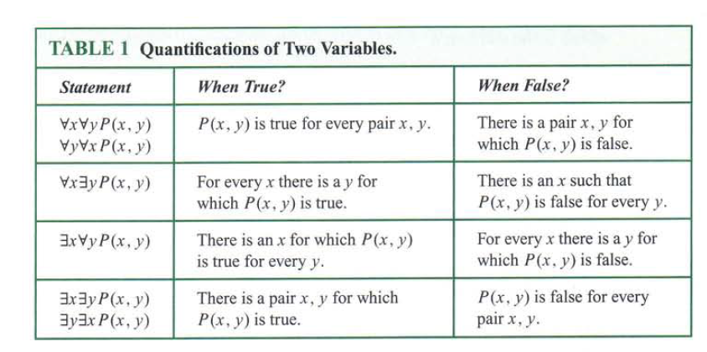
¬(∀x ∀y P(x,y)) = ∃x ¬(∀y P(x,y)) = ∃x ∃y ¬ P(x,y)
¬(∀x ∃y P(x,y)) = ∃x ¬(∃y P(x,y)) = ∃x ∀y ¬ P(x,y)
¬(∃x ∀y P(x,y)) = ∀x ¬(∀y P(x,y)) = ∀x ∃y ¬ P(x,y)
¬(∃x ∃y P(x,y)) = ∀x ¬(∃y P(x,y)) = ∀x ∀y ¬ P(x,y)

Slide 40
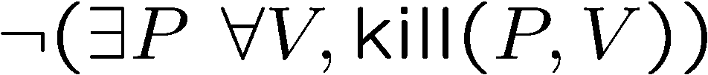
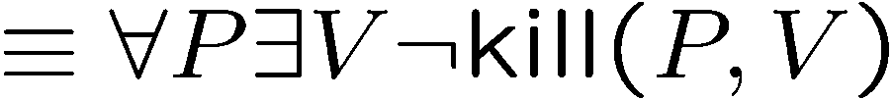
More on Negations
There is an anti-virus program killing every computer virus.
What is the negation of this sentence?
For every program, there is some virus that it can not kill.

Slide 41
Exercises
There is a smallest positive integer.
There is no smallest positive real number.
There are infinitely many prime numbers.

Slide 42
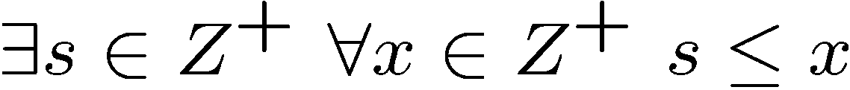
Exercises
There is a smallest positive integer.
There is no smallest positive real number.
There are infinitely many prime numbers.
¬(∃s∈Z⁺ ∀x∈Z⁺ s ≤ x)
∀s∈Z⁺ ¬(∀x∈Z⁺ s ≤ x)
∀s∈Z⁺ ∃x∈Z⁺ ¬(s ≤ x)
∀s∈Z⁺ ∃x∈Z⁺ s ≰ x
∀s∈Z⁺ ∃x∈Z⁺ x < s

Slide 43
Quantifiers
Negation
Multiple quantifiers
Arguments of quantified statements

Slide 44
Predicate Calculus Validity
Propositional validity
True no matter what the truth values of A and B are
Predicate calculus validity
∀z [Q(z)  P(z)] → [∀x.Q(x)  ∀y.P(y)]
True no matter what
the Domain is,
or the predicates are.
That is, logically correct, independent of the specific content.

Slide 45
Predicate Calculus Validity
Propositional validity
True no matter what the truth values of A and B are
A | B | A→B | B→A | (A→B) ∨ (B→A)
0 | 0 | 1 | 1 | 1
0 | 1 | 1 | 0 | 1
1 | 0 | 0 | 1 | 1
1 | 1 | 1 | 1 | 1
Tautology

Slide 46
Predicate Calculus Validity
Predicate calculus validity
∀z [Q(z)  P(z)] → [∀x.Q(x)  ∀y.P(y)]
True no matter what
the Domain is,
or the predicates are.
Similar to Tautology
Of Propositional logic
That is, logically correct, independent of the specific content.
If hypothesis is false, the whole statement is true
What happens, if the hypothesis is true?
In this case, for each Z, Q(Z) and P(Z) must be individually true.
So, the conclusion follows
So the statement is true

Slide 47







Arguments with Quantified Statements
Universal instantiation:
Universal modus ponens:
Universal modus tollens:

Slide 48
Arguments with Quantified Statements
Universal instantiation:
All men are mortal. Socrates is a man. ∴ Socrates is mortal.
Simplify r^{k+1} × r
r^{k+1} × r = r^{k+1} × r¹ = r^{k+1+1} = r^{k+2}
We know from math:
For all real numbers x and all integers m and n, x^{m} × x^{n} = x^{m+n}
For all real numbers x, x = x¹.
1 & UI
2 & UI

Slide 49
Arguments with Quantified Statements
Universal modus ponens:
If a number is even, then its square is even. k is a particular number that is even.
(We could say: 6 is even, i.e., k =6) ∴ k² is even.
(∴ 6² = 36 is even)
E(x)
S(x)
∀x, if x is even then x² is even.
∀x, E(x) → S(x)
E(6)
∴ S(6)
Formally

Slide 50
Arguments with Quantified Statements
Universal modus tollens:
All human beings are mortal. Zeus is not mortal. ∴ Zeus is not human.
H(x)
M(x)
∀x, if x is human then x is mortal.
∀x, H(x) → M(x)
¬M(Zeus)
∴ ¬ H(Zeus)
Formally

Slide 51
All professors are absent-minded
Sohel Rahman is not absent-minded
Conclusion:???
1
c
Calculate c.
Are you using any argument we taught?
1
Sohel Rahman is not a professor.
∀x professor(x) → absent-minded(x)
~absent-minded(Sohel)
∴ ~professor(Sohel)
All criminals frequently go to that room
Sohel frequently goes to that room
Conclusion: Sohel is a criminal
Valid Argument?
∀x criminal(x) → room(x)
room(Sohel)
∴ criminal(Sohel)
NO

Slide 52

Universal Generalization
valid rule
Informally, if we could prove that R(c) is true for an arbitrary c
(in a sense, c is a “variable”), then we could prove the for all statement.
e.g. given any number c, 2c is an even number
=> for all x, 2x is an even number.
Remark: Universal generalization is often difficult to prove, we will
introduce mathematical induction to prove the validity of for all statements.

Slide 53
Argument Validity
To say that an argument form is valid means the following:
No matter what particular predicates are substituted for the predicate symbols in its premises, if the resulting premise statements are all true, then the conclusion is also true.
An argument is called valid if, and only if, its form is valid

Slide 54
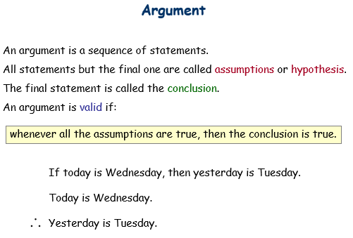
Recall from Proposition…

Slide 55
Valid Rule?
∀z [Q(z)  P(z)] → [∀x.Q(x)  ∀y.P(y)]
Proof: Give countermodel, where
∀z [Q(z)  P(z)] is true,
but ∀x.Q(x)  ∀y.P(y) is false.
In this example, let domain be integers,
Q(z) be true if z is an even number, i.e. Q(z)=even(z)
P(z) be true if z is an odd number, i.e. P(z)=odd(z)
Find a domain,
and a predicate.
Then ∀z [Q(z)  P(z)] is true, because every number is either even or odd.
But ∀x.Q(x) is not true, since not every number is an even number.
Similarly ∀y.P(y) is not true, and so ∀x.Q(x)  ∀y.P(y) is not true.

Slide 56
Valid Rule?
∀z D [Q(z)  P(z)] → [∀x D Q(x)  ∀y D P(y)]
Proof: Assume ∀z [Q(z)P(z)].
So Q(z)P(z) holds for all z in the domain D.
Now let c be some element in the domain D.
So Q(c)P(c) holds (by instantiation), and therefore Q(c) by itself holds.
But c could have been any element of the domain D.
So we conclude ∀x.Q(x). (by generalization)
We conclude ∀y.P(y) similarly (by generalization). Therefore,
∀x.Q(x)  ∀y.P(y) QED.

Slide 57
Summary
This finishes the introduction to logic, half of the first part.
In the other half we will use logic to do mathematical proofs.
At this point, you should be able to:
Express (quantified) statements using logic formula
Use simple logic rules (e.g. DeMorgan, contrapositive, etc)
Fluent with arguments and logical equivalence

